Slide 1

Senior Missionary Coordinators
Understanding Your Calling

Slide 2
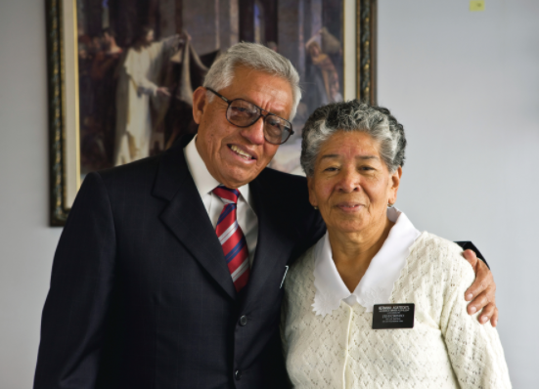
Understanding Your Calling
Senior Missionary Coordinators (SMCs) are full-time Senior Service Missionaries, serving around 30 hours a week.

Slide 3
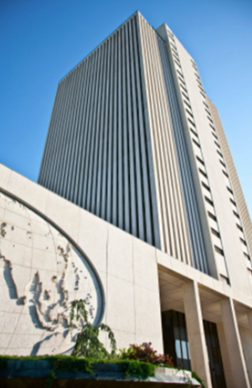
Understanding Your Calling
SMCs represent both the Service Mission Office (SMO) and the Missionary Department

Slide 4
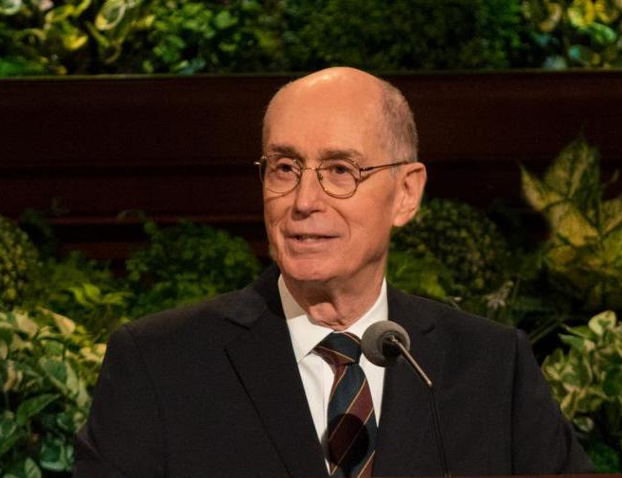
Purpose of the Service Mission Office
The SMO helps individuals and couples serve the Savior by providing organized and meaningful opportunities for them to build His kingdom on the earth, bless the lives of others, and experience spiritual growth.

Slide 5
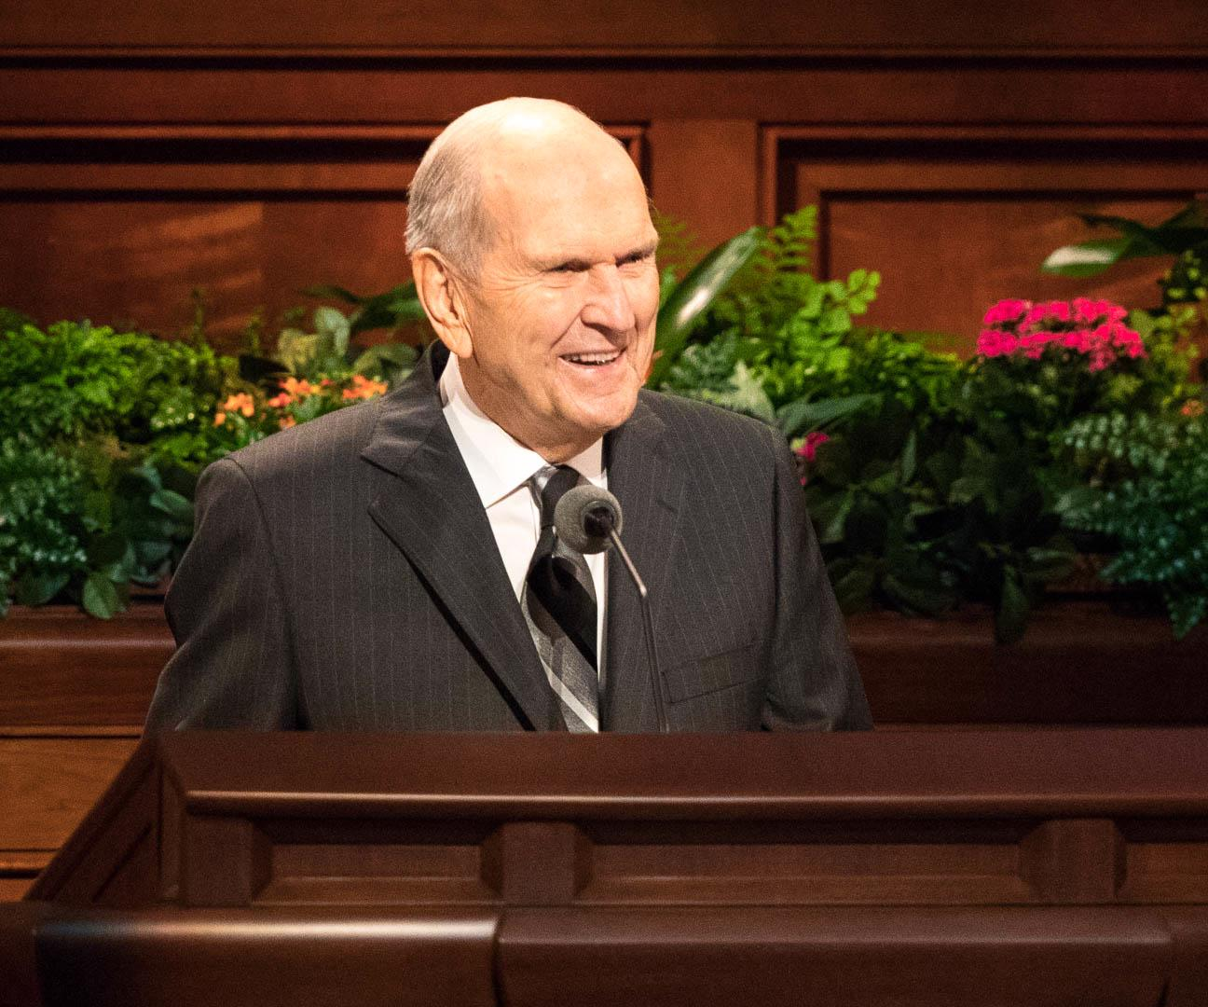
Service Mission Office Core Values
We ensure that the Service Missionary Programs are aligned with priesthood direction from the presiding councils of the Church.
We work in harmony with the Missionary Department to provide missionary opportunities around the world and around the corner.

Slide 6
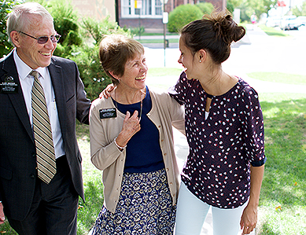
Service Mission Office Core Values
We promote ways to help every Senior Service Missionary and young Service Missionary feel spiritually fulfilled and temporally successful in each mission assignment.
We assist Church departments and operation managers in onboarding missionaries as part of the Church’s mixed work force, which consists of employees, Senior Service Missionaries, volunteers, and young Service Missionaries.

Slide 7
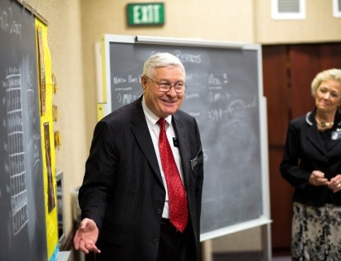
Service Mission Office Core Values
We encourage priesthood leaders and members on how Senior missionaries and Senior service missionaries bless the children of God, His Church, and those who serve.

Slide 8
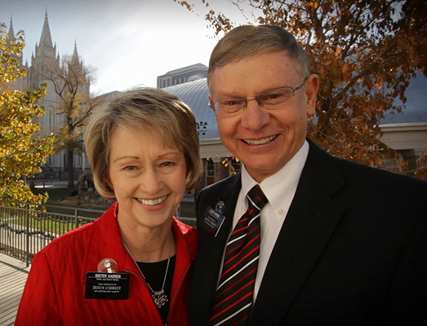
SMCs’ Areas of Responsibility - 1
1. SMCs facilitate mission calls for full-time Senior Missionaries and part-time Senior Service Missionaries. SMCs assist missionary candidates and priesthood leaders with the online applications for missionary recommendations. SMCs promote positive experiences for seniors as missionaries.

Slide 9
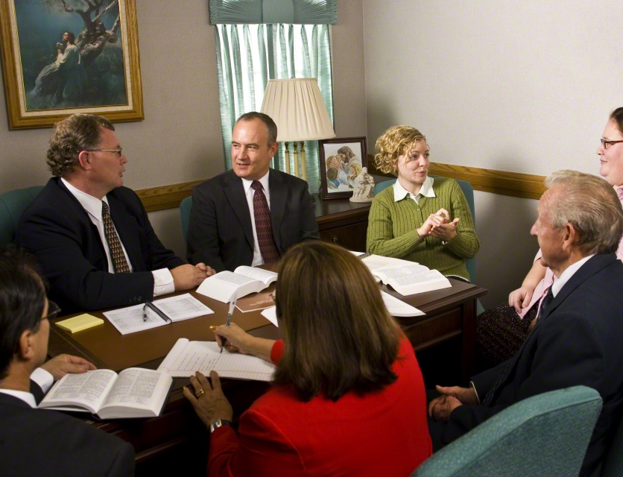
SMCs’ Areas of Responsibility - 2
2. Help Stake and Ward Leaders carry out Unit assigned opportunities. This includes: (a) educating the leaders as to the missionary opportunities for senior members; (b) working with Stake Presidents who must approve missionary assignments and changes to their assignments; and (c) training anyone who is asked by the Stake President to support missionary work, such as Stake Senior Missionary Specialists.

Slide 10
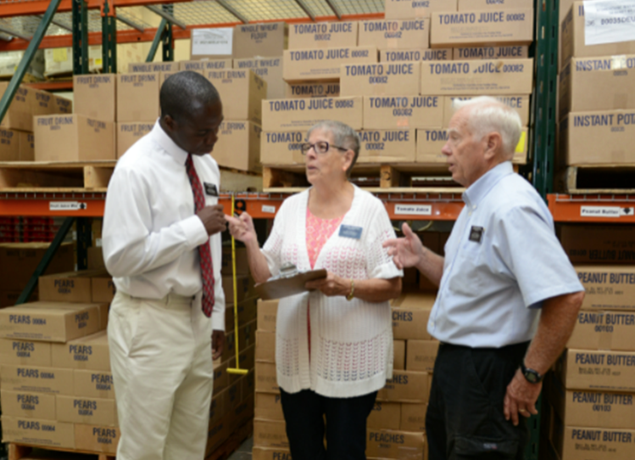
SMCs’ Areas of Responsibility - 3
3. SMCs assist Operation Managers develop an effective workforce. This includes (a) making sure that the Senior Missionary Website shows missionary opportunities that are available for potential missionaries to consider, (b) helping to make sure missionary releases or extensions are handled correctly; and (c) informing priesthood leaders of the operations’ needs.

Slide 11
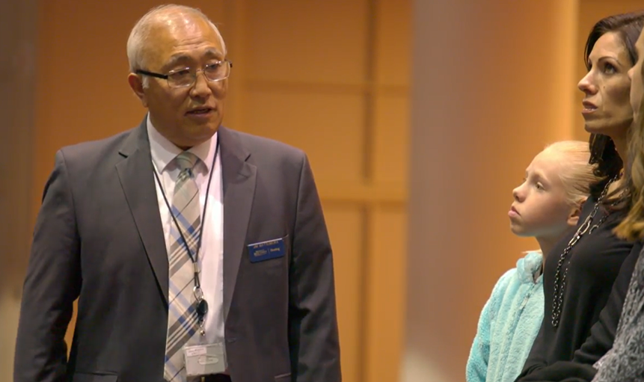
SMCs’ Areas of Responsibility - 4
4. SMCs act as Ambassadors for the Senior Missionary Program. When invited, SMCs attend Stake Conferences, host devotionals and firesides, participate in ward and stake councils, and otherwise promote missionary work among senior Church members.

Slide 12
Resources and Tools
People
Under the direction of the Service Mission Office (SMO) and in collaboration with the Missionary Department, missionary work for senior members is facilitated and assisted by Senior Missionary Coordinators (SMCs) with the support and assistance of Service Mission Office Support Advisers. The Support Advisers for the NASW Area are Elder Layne Rushforth and Sister Sharon Rushforth.
SMCs are assigned over a Senior Missionary Group, made up of one or more Coordinating Councils.
The North America Southwest Area is divided into ten missionary “groups” in Arizona, Nevada, New Mexico, Texas, and Oklahoma.
The Las Vegas Group consists of four Coordinating Council that include 31 stakes.
Elder Thomas A. Thomas is over the North and West Coordinating Councils.
Elder Jonathon W. Bunker is over the South and East Coordinating Councils.

Slide 13
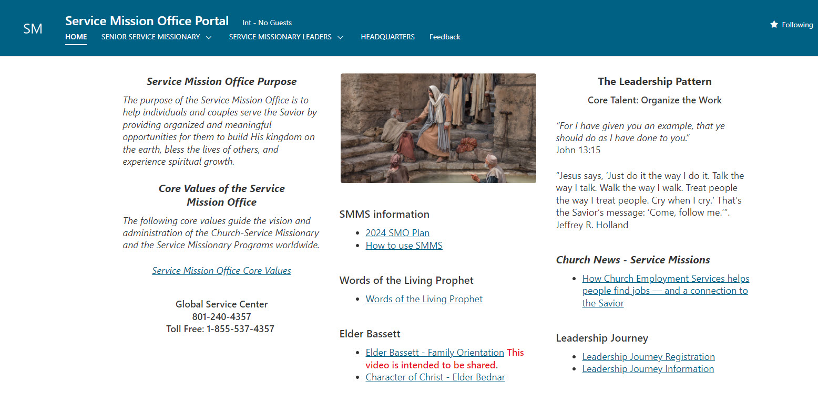
Resources and Tools
The Service Mission Office Portal

Slide 14
Resources and Tools
Missionary Websites
Acronym | For | Description
SMW | Members | Senior Missionary Website. Used by members to find a “missionary opportunity” and to connect to an application for a recommendation to serve a mission.
MRS | Bishops and Stake Presidents | Missionary Recommendation System. Used by priesthood leaders to formally approve and recommend members as missionaries.
SMMS | Operation Managers and Stake Presidents | Service Missionary Management System. This is used by Operation Managers and Stake Presidents to approve missionary assignments and to modify them.
CDOL | Church leaders and missionary advisors | Church Directory of Organizations and Leaders. This is a worldwide directory of the Church’s organizations and Church leaders.

Slide 15
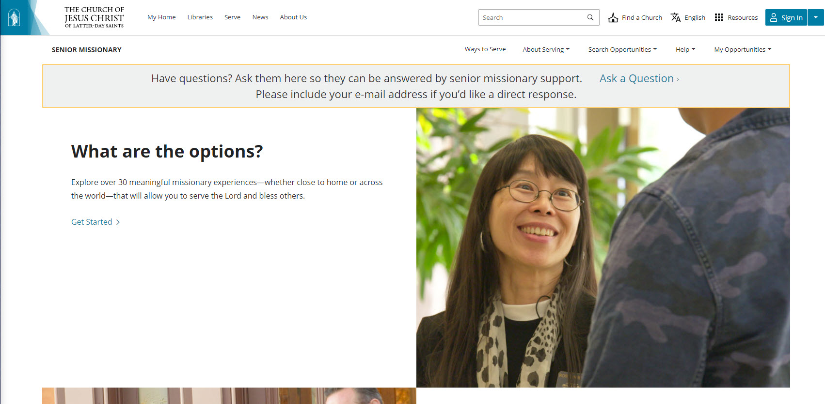
Resources and Tools
The Senior Missionary Website (SMW)

Slide 16
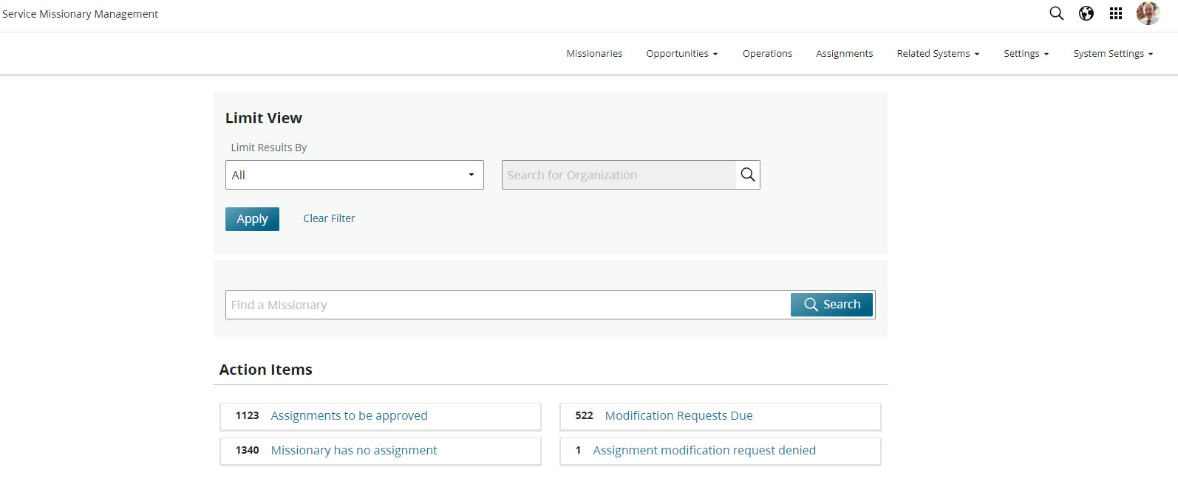
Resources and Tools
Service Missionary Management System (SMMS)

Slide 17
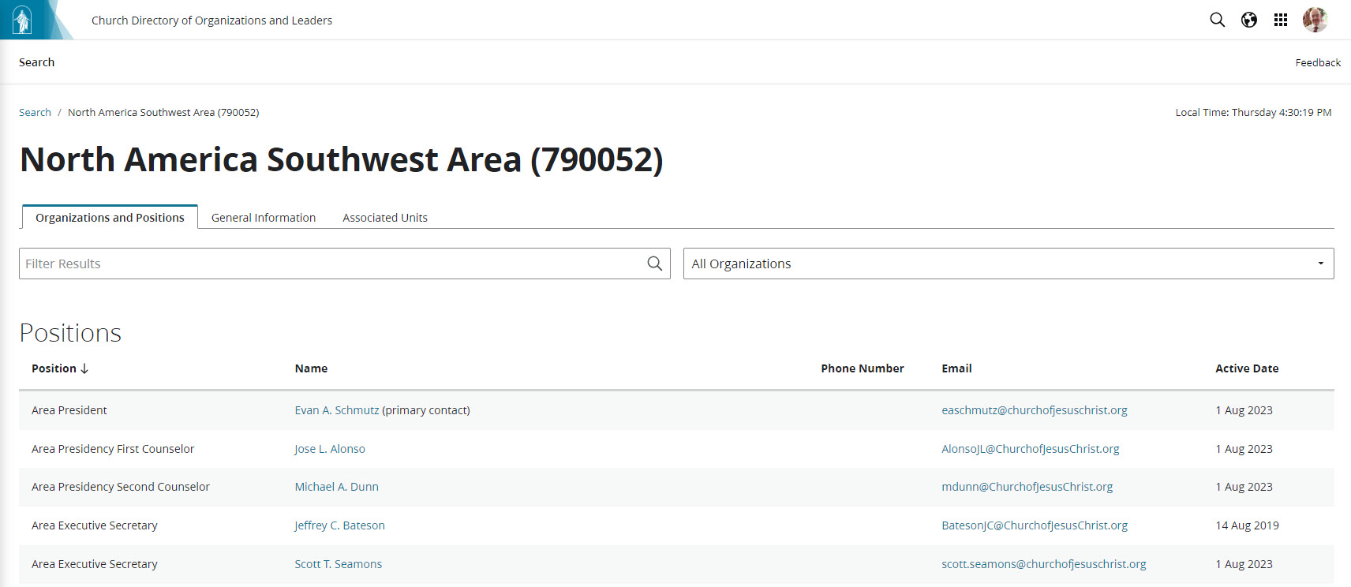
Resources and Tools
The Church Directory of Organizations and Leaders (CDOL)

Slide 18
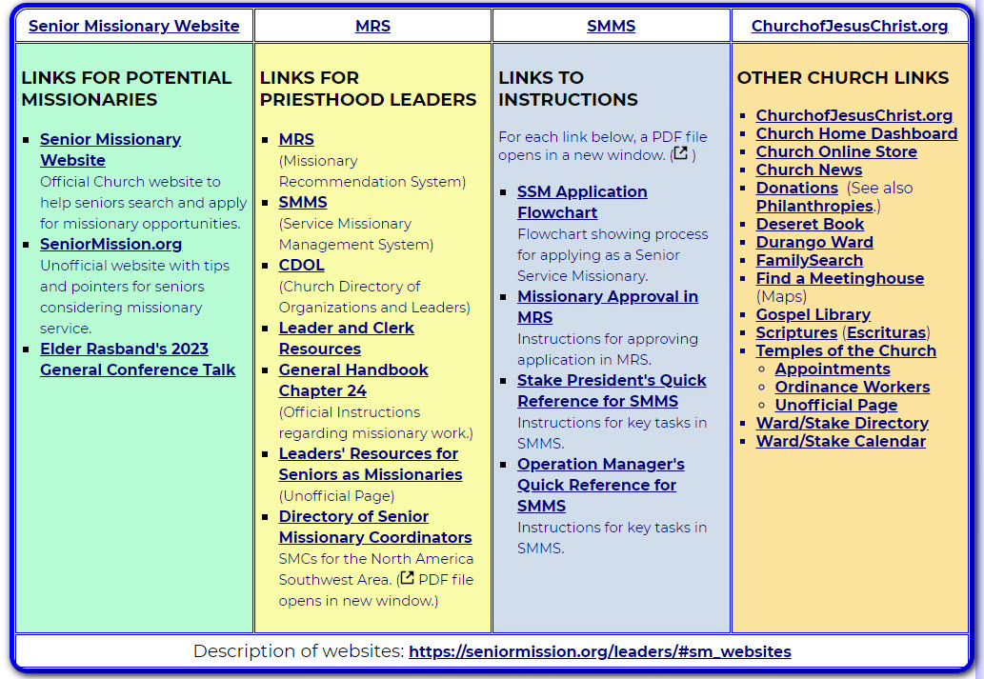
Resources and Tools
Links to Missionary Websites

Slide 19

Daily Tasks for SMCs
Check your Group Email and Each of your Personal Church Emails
Follow up on applications stalled in MRS
Communicate with and act as a liaison between potential missionaries, Priesthood Leaders and Operation Managers
Check your Dashboard in SMMS
Missionaries without assignments
Missionaries with proposed modifications
Send Task Requests to your Support Advisers, as needed
Ask your Support Advisers questions, as needed

Slide 20
Recurring Tasks
Build Relationships with your Area Seventies, Stake Presidents, and Operation Managers.
Train Stake Senior Missionary Specialists or others in a similar role
Seek opportunities to encourage missionary service:
Attend Stake Conferences
Host Devotionals
Participate in Ward and Stake Councils
Attend webinars and fill assignments
Wear name badge and missionary dress when visiting
Monitor Operations and Stakes to help the Stakes provide missionaries for the Operations.

Slide 21
Meetings for SMCs
Senior Missionary Coordinators participate in an area-wide SMC one-hour video conference on the first and third Wednesdays of each month at 12:00 p.m. Pacific Time.
SMCs participate in a one-hour Global SMC video conference once a month on the second Wednesday of each month at 10:30 a.m. Mountain Time.
SMCs have an informal video chat with their Support Advisers normally scheduled during the second and fourth weeks of the month.
Additional conferences and meetings may be scheduled.

Slide 22
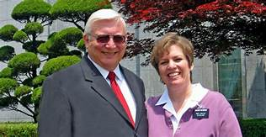
Special Task
Enjoy Your Calling!

