Slide 1
Senior Missions
How we can change the mindset

Slide 2
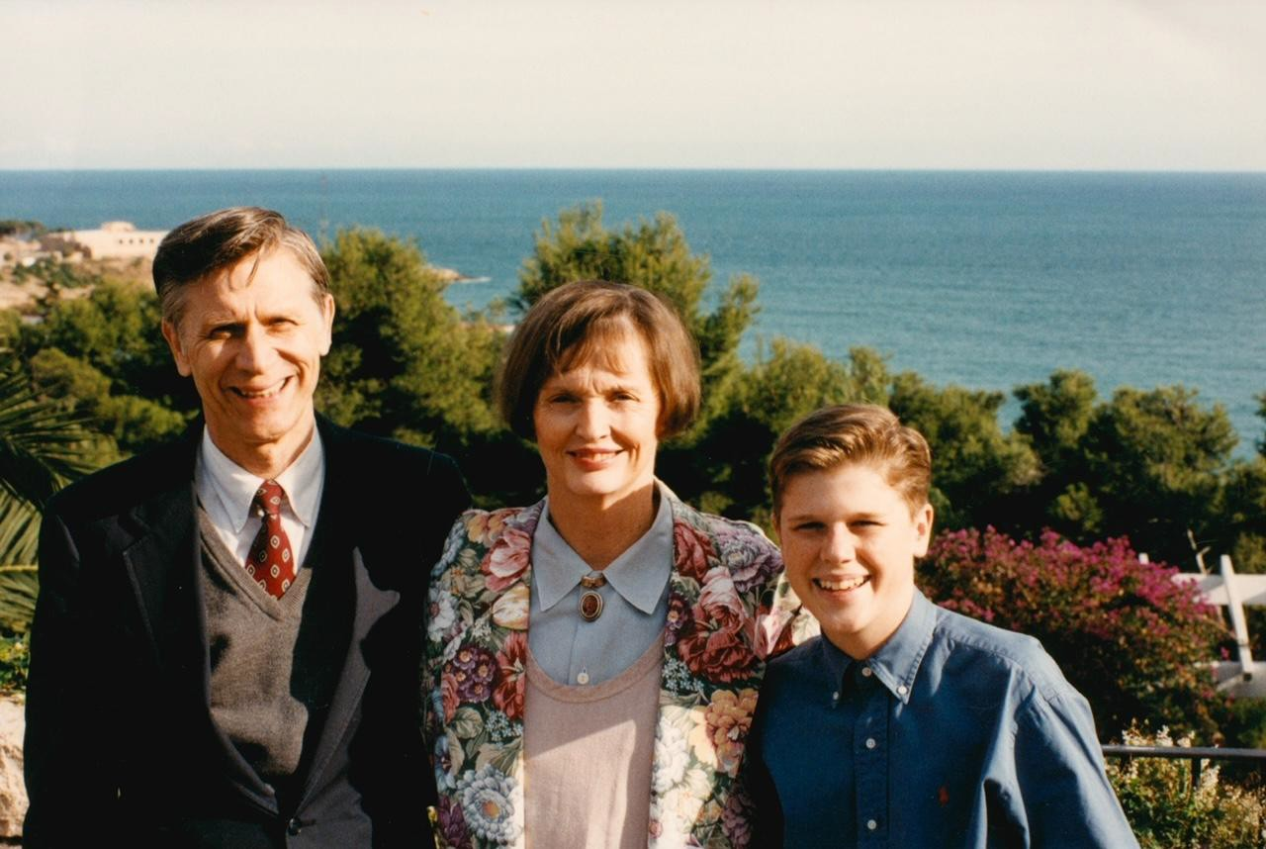
The impact is massive
My heroes are senior missionaries… because they weren’t asked to serve like we were.

Slide 3
Why aren’t more people serving?
Misconceptions about qualiﬁcations
Most people qualify
Ignorance of available opportunities
Many opportunities to serve
Load of local leaders
Stake leaders can take on much of the administration

Slide 4
7 common misconceptions
Retired/Old
Wealthy
Healthy
Live away
Full-time
Married
Proselytize

Slide 5
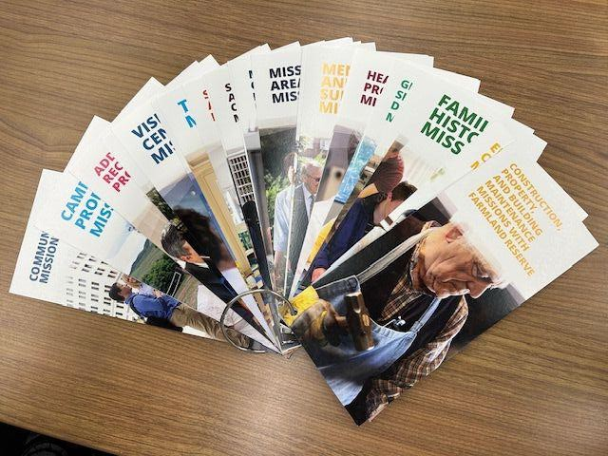
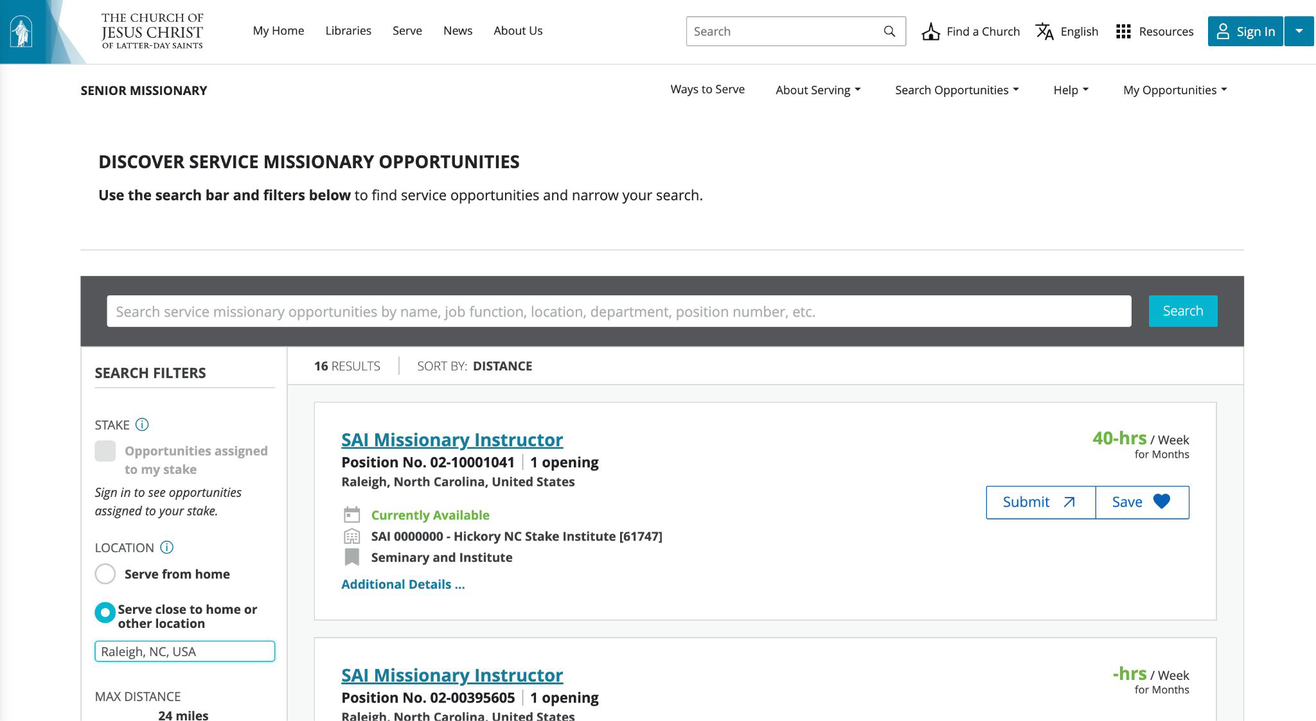
Help them see the possibilities!

Slide 6
The recommendation process
Complete application form online
Explore
Look at opportunities online
Interview with Bishop
Consultative conversation with Tyler Haws or Heidi Sass
Operations manager approves recommendation
Approve
Bishop submits recommendation
Stake pres. submits recommendation
Extend call
Stake pres. prints call letter
Stake pres. extends call and sets apart
Missionary begins service!

Slide 7
Why aren’t more people serving?
The power of
VIDEO
Misconceptions about qualiﬁcations
Most people qualify
Ignorance of available opportunities
Many opportunities to serve
Load of local leaders
Stake leaders can take on much of the administration

Slide 8
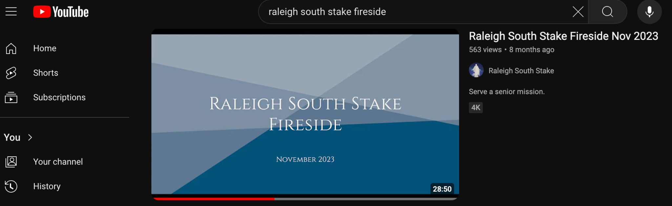
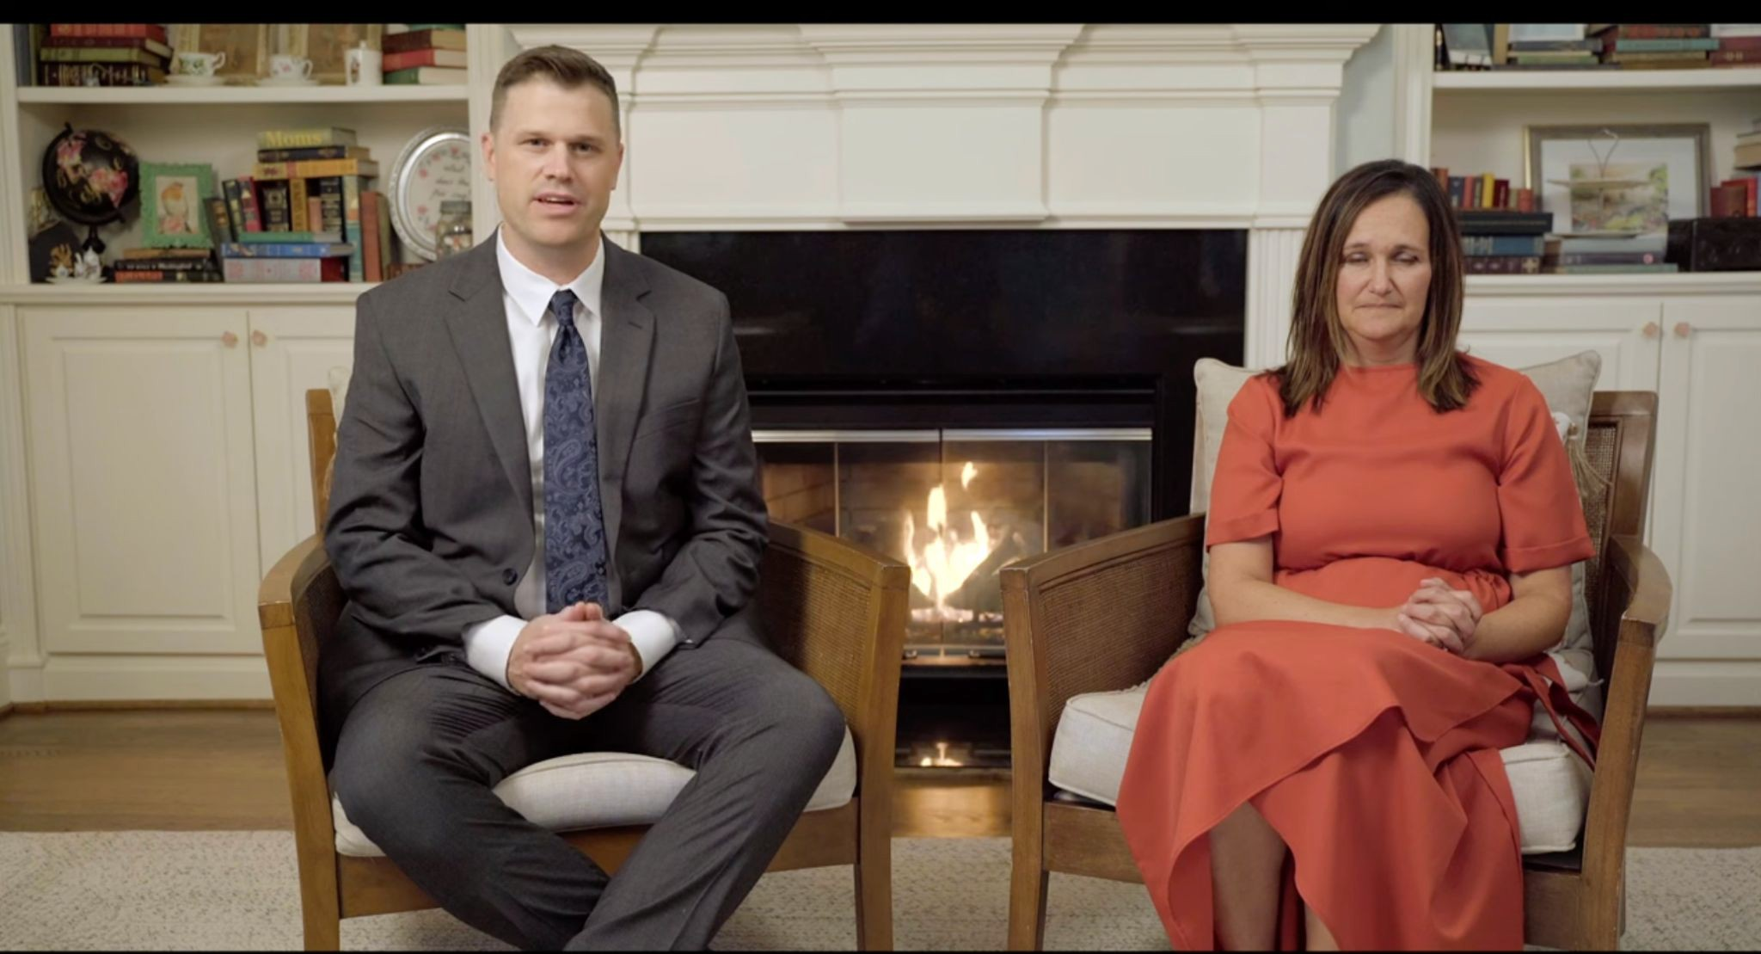
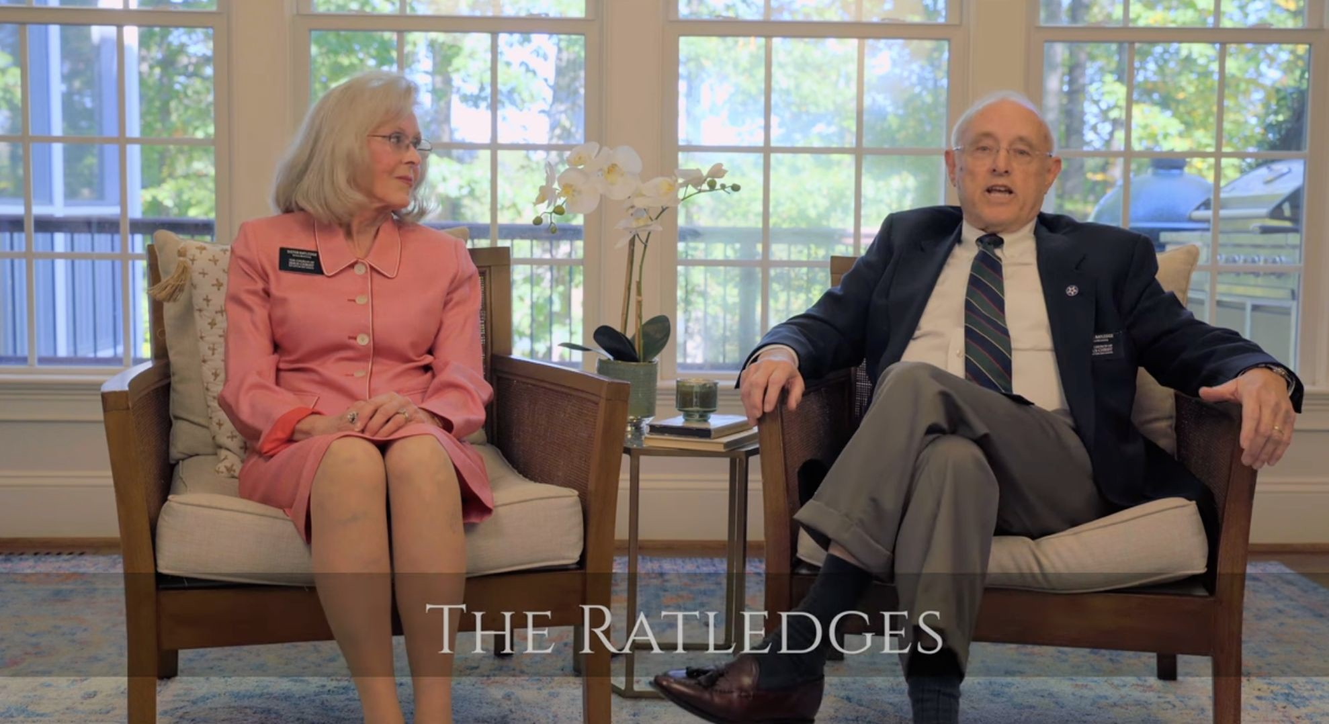
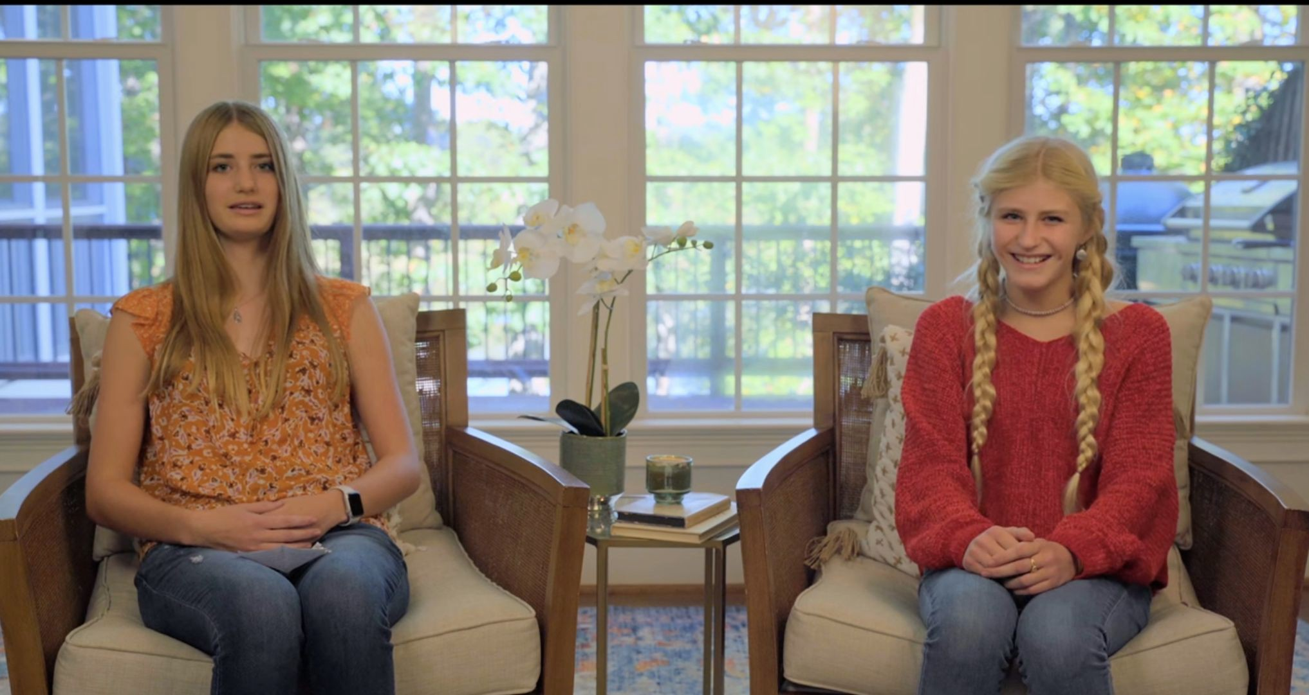
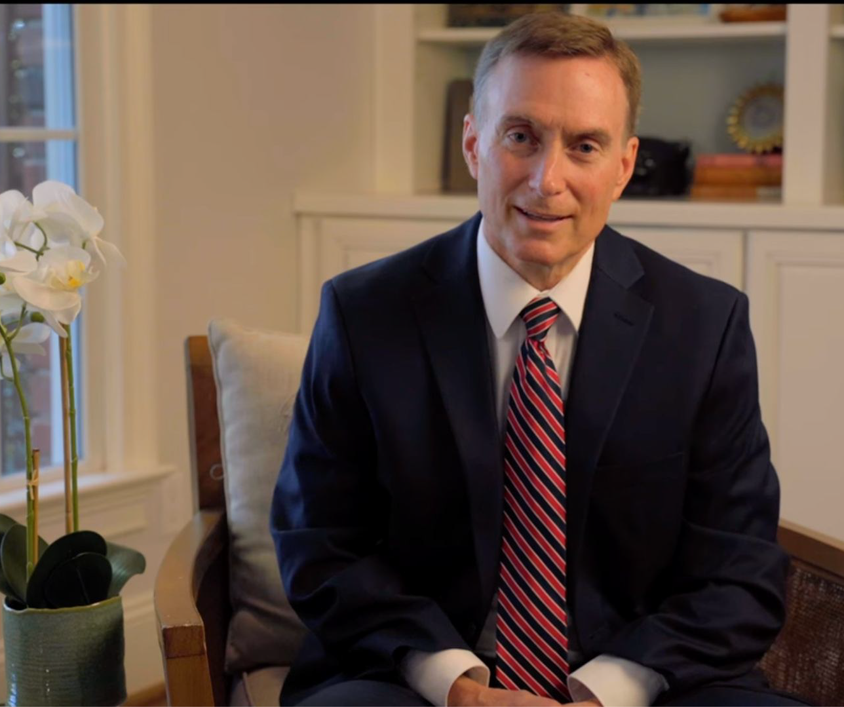
YouTube: Raleigh South Stake Fireside

Slide 9

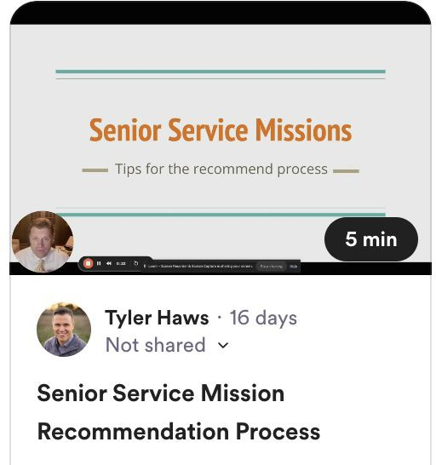
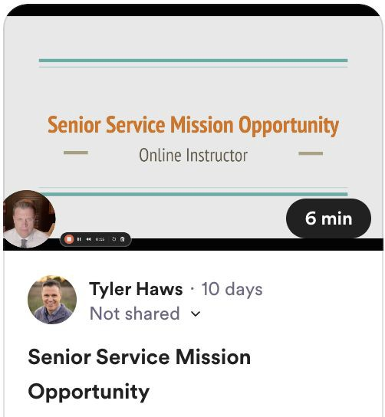
Micro trainings

Slide 10
"Ye are the light of the world. A city that is set on a hill cannot be hid. Neither do men light a candle, and put it under a bushel, but on a candlestick; and it giveth light unto all that are in the house. Let your light so shine before men, that they may see your good works, and glorify your Father which is in heaven."
Matthew 5:14-16

