Slide 1
Delegation at Operations
SETUP ACTIONS (DO THESE FIRST)
"DELEGATION AT OPERATIONS" P-0070-EN

Slide 2
Overview
Update the General Contact Information
This is how to set up the system to show who to contact about the operation
Add SMMS users for the Operation
Set up the system for others you permit to see and change the operation data in SMMS
The “Primary Contact” and “Display as Contact” boxes will be grayed until the user agrees to share contact information.
Agree to share your Contact Information
How a user agrees to share their contact information in SMMS so it will show on the SMW opportunity
postings
This step is required to have contact information displayed on the Senior Missionary Website.

Slide 3
Update the General Contact Information
Open SMMS or return to the Dashboard page.
On the Menu at the top of the page, click on “Operations” to see a list of your operations. Click on the “Operation ID” to open the operation’s detail page.
If the General Contact information on the far right (under Operation Contact Preview) is not
correct, click on “Edit Operation”.
Enter the correct contact information in all 3 fields and click “Save”.

Slide 4
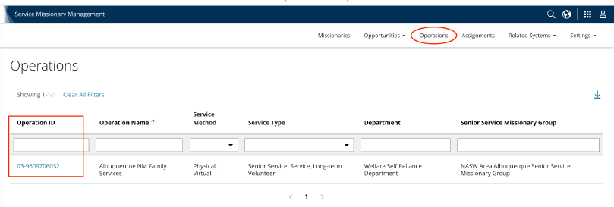

Slide 5
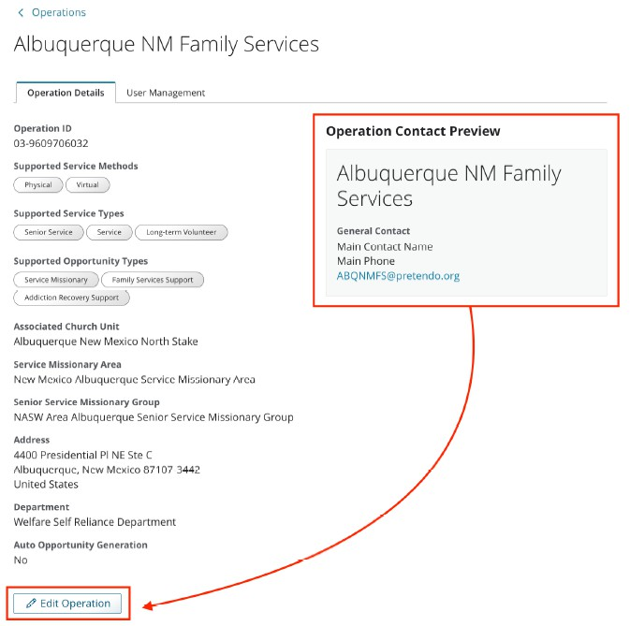
Often shows as tbd
tbd tbd
Scroll all the way down to find the Edit button

Slide 6
Scroll all the way down to find these boxes

Slide 7
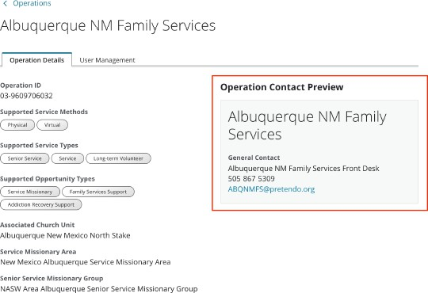

Slide 8
Add SMMS Users for the Operation
Open SMMS or return to the Dashboard page.
On the Menu at the top of the page, click on “Operations” to see a list of your operations. Click on the “Operation ID” to open the operation’s detail page.
Click on the “User Management” tab.
To add a user, enter their Church Account Username and choose a role.
Support role is view only.
Operation Delegated Approver role allows person to view and approve tasks on behalf of the Operation Manager.
Click on “Add User Responsibility”
To remove a user, click on the trash can icon to the right of their name and click “Yes, Remove Responsibility” to confirm the action.

Slide 10
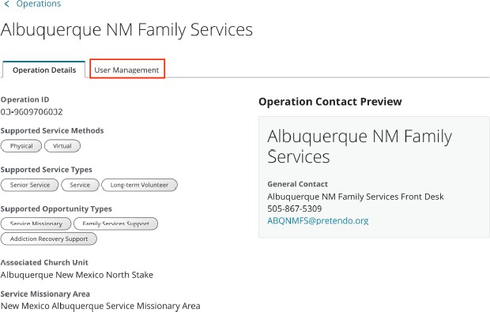
Only visible to
Operation Manager
You can have more than
one Operation Manager

Slide 11
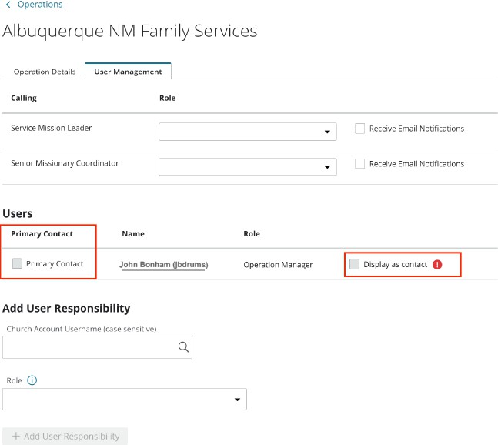
No one is checked initially
You can only have
one Primary Contact
You can have more than
one contact displayed

Slide 12
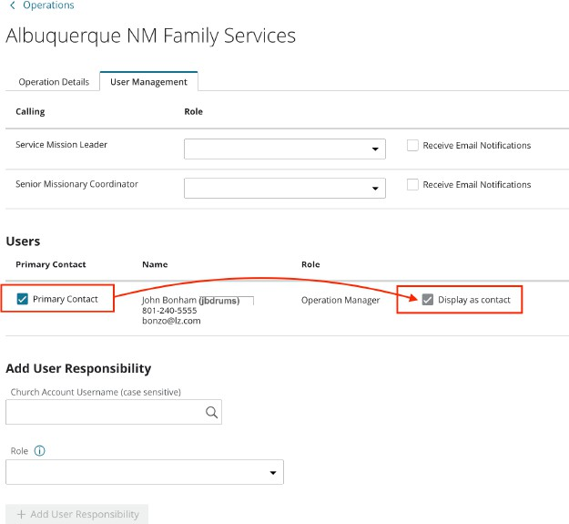
The Primary Contact will always be displayed as contact

Slide 13
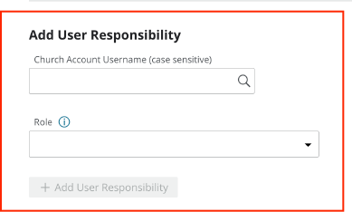
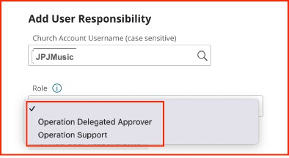
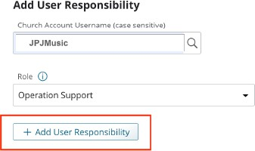

Slide 14
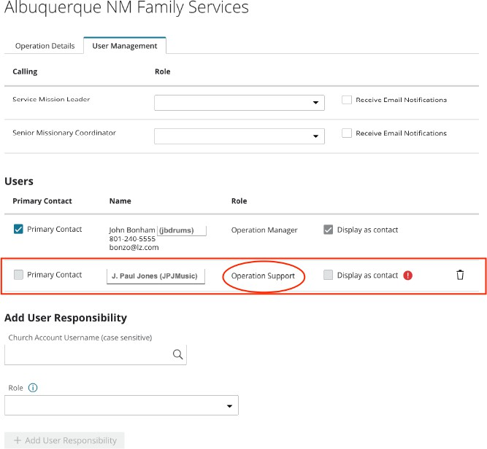
No trash can by Operation Manager. They must be removed by Salt Lake.
The check boxes are initially greyed out
The trash can deletes the user

Slide 15
Agree to share your Contact Information
Open SMMS or return to the Dashboard page.
On the Menu at the top of the page, click on “Settings”, then click on “User Profile”. Fill out the Display Name, Phone, and Email boxes and click “Agree”.

Slide 16
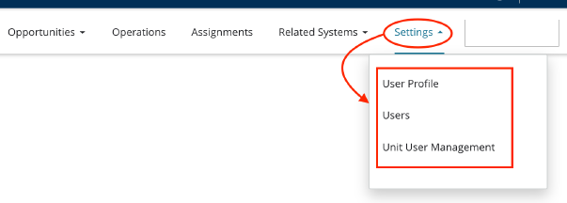
User Profile only shows
after they have been entered
as a person with access

Slide 17
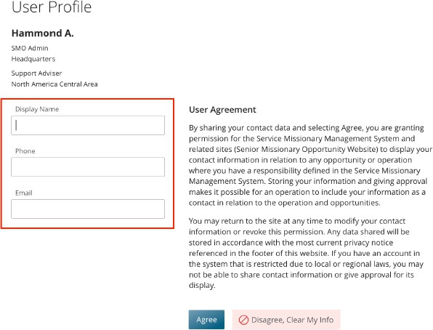
First name and Last Initial indicates they have not filled out and agreed
to this yet

Slide 18
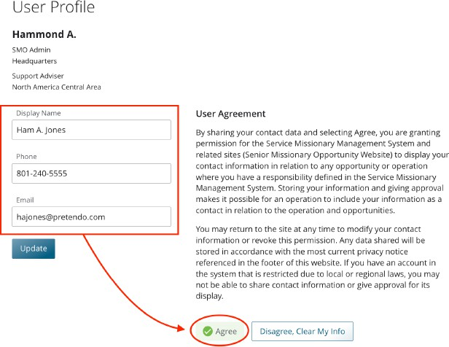

Slide 19
Delegation at Operations Summary
First thing you train them on
Operation Details not showing correctly
Opportunity website not showing a contact or not showing correct contact
Three steps to do it
General Contact Information
Adding Users
Agree to share Contact Information
Can be done on a Phone
Can be done simultaneously
Then train them on Approval, Early Release, Extensions, and List of Missionaries

